Slide 1

BIG DATA

Slide 2
INTRODUCTION
Big Data may well be the Next Big Thing in the IT world.
Big data burst upon the scene in the first decade of the 21st century.
The first organizations to embrace it were online and startup firms. Firms like Google, eBay, LinkedIn, and Facebook were built around big data from the beginning.
Like many new information technologies, big data can bring about dramatic cost reductions, substantial improvements in the time required to perform a computing task, or new product and service offerings.

Slide 3
WHAT IS BIG DATA?
‘Big Data’ is similar to ‘small data’, but bigger in size
but having data bigger it requires different approaches:
Techniques, tools and architecture
an aim to solve new problems or old problems in a
better way
Big Data generates value from the storage and processing of very large quantities of digital information that cannot be analyzed with traditional computing techniques.

Slide 4
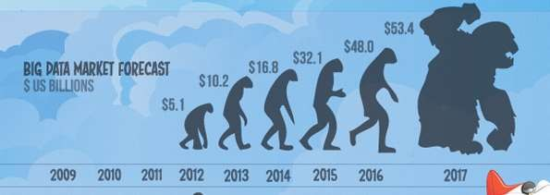
WHAT IS BIG DATA
Walmart handles more than 1 million customer transactions every hour.
Facebook handles 40 billion photos from its user base.
Decoding the human genome originally took 10years to process; now it can be achieved in one week.

Slide 5
THREE CHARACTERISTICS OF BIG DATA
V3S
Volume
Data quantity
Velocity
Data Speed
Variety
Data Types

Slide 6
1ST CHARACTER OF BIG DATA
VOLUME
A typical PC might have had 10 gigabytes of storage in 2000.
Today, Facebook ingests 500 terabytes of new data every day.
Boeing 737 will generate 240 terabytes of flight data during a single flight across the US.

Slide 7
2ND CHARACTER OF BIG DATA
VELOCITY
Clickstreams and ad impressions capture user behavior at millions of events per second
high-frequency stock trading algorithms reflect market changes within microseconds
machine to machine processes exchange data between billions of devices
infrastructure and sensors generate massive log data in real-time
on-line gaming systems support millions of concurrent users, each producing multiple inputs per second.

Slide 8
3RD CHARACTER OF BIG DATA
VARIETY
Big Data isn't just numbers, dates, and strings. Big Data is also geospatial data, 3D data, audio and video, and unstructured text, including log files and social media.
Traditional database systems were designed to address smaller volumes of structured data, fewer updates or a predictable, consistent data structure.
Big Data analysis includes different types of data

Slide 9
STORING BIG DATA
Analyzing your data characteristics
Selecting data sources for analysis
Eliminating redundant data
Establishing the role of NoSQL
Overview of Big Data stores
Data models: key value, graph, document, column-family
Hadoop Distributed File System
HBase
Hive

Slide 10
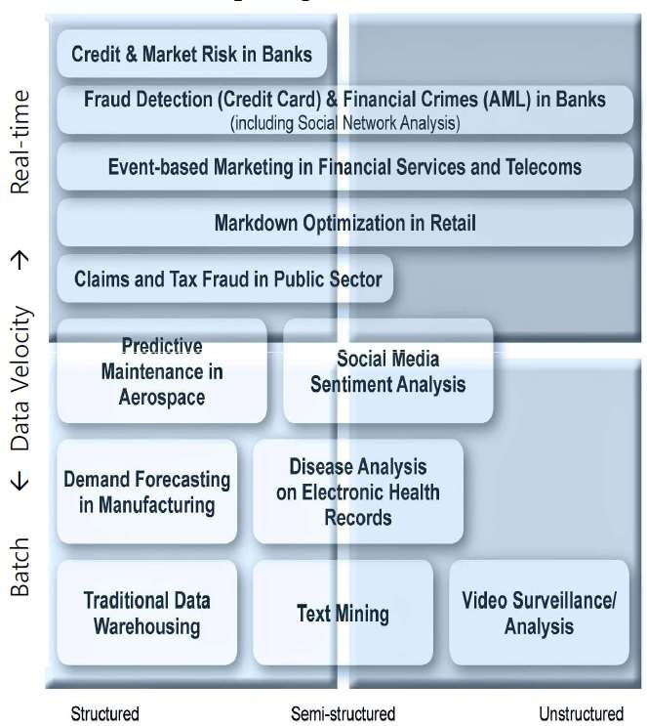
THE STRUCTURE OF BIG DATA
Structured
Most traditional data sources
Semi-structured
Many sources of big data
Unstructured
Video data, audio data
11

Slide 11
WHY BIG DATA
Growth of Big Data is needed
Increase of storage capacities
Increase of processing power
Availability of data(different data types)

Slide 12
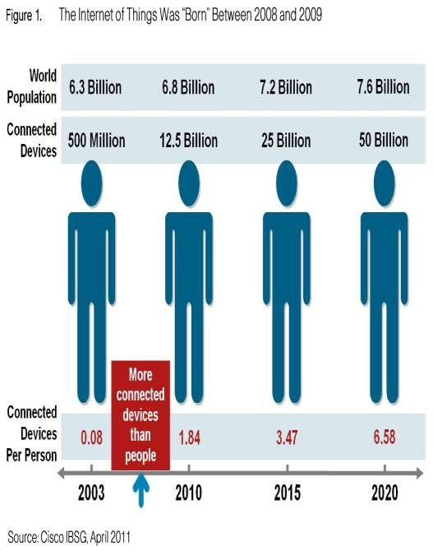
WHY BIG DATA
FB generates 10TB daily
Twitter generates 7TB of data
Daily
IBM claims 90% of today’s
stored data was generated
in just the last two years.

Slide 13
BIG DATA SOURCES
Users
Large and growing files (Big data files)
Application
Systems
Sensors

Slide 14
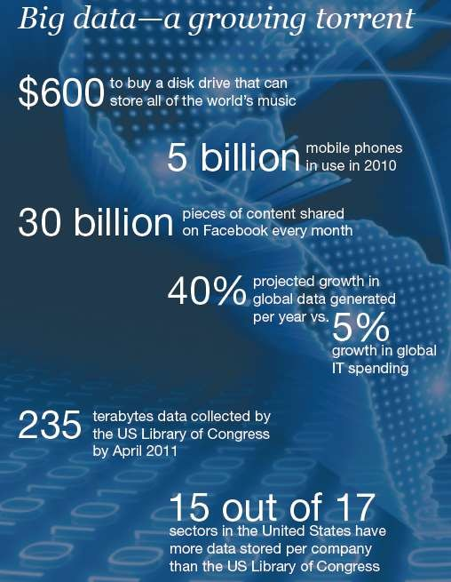
DATA GENERATION POINTS
EXAMPLES
Mobile Devices
Microphones Readers/Scanners Science facilities Programs/ Software Social Media Cameras

Slide 15
BIG DATA ANALYTICS
Examining large amount of data
Appropriate information (about data)
Identification of hidden patterns, unknown correlations
Better business decisions: strategic and operational
Effective marketing, customer satisfaction, increased revenue

Slide 16
TYPES OF TOOLS USED IN BIG-DATA
Where processing is hosted?
Distributed Servers / Cloud (e.g. Amazon EC2)
Where data is stored?
Distributed Storage (e.g. Amazon S3)
What is the programming model?
Distributed Processing (e.g. MapReduce)
How data is stored & indexed?
High-performance schema-free databases (e.g. MongoDB)
What operations are performed on data?
Analytic / Semantic Processing

Slide 17
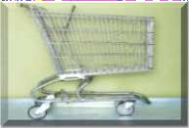

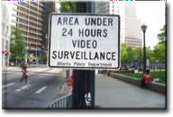


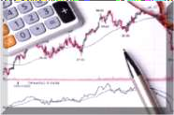


Application Of Big Data analytics
Smarter Healthcare
Multi-channel
sales
Homeland Security
Telecom
Traffic Control
Trading Analytics
Manufacturing
Search Quality

Slide 18
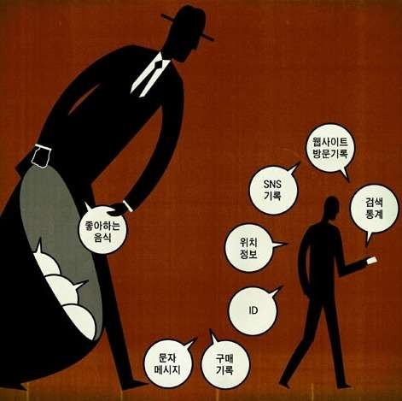
RISKS OF BIG DATA
Will be so overwhelmed
Need the right people and solve the right problems
Costs escalate too fast
Isn’t necessary to capture 100%
Many sources of big data is privacy
self-regulation (data compression)
Legal regulation
20

Slide 19
HOW BIG DATA IMPACTS ON IT
Big data is a troublesome force presenting opportunities with challenges to IT organizations.
By 2015 4.4 million IT jobs in Big Data ; 1.9 million is in US itself
In 2017, Data scientist’s was No. 1 Job in the Harvard’s ranking.

Slide 20
BENEFITS OF BIG DATA
Real-time big data isn’t just a process for storing petabytes or exabytes of data in a data warehouse,
It’s about the ability to make better decisions and take meaningful actions at the right time.
Fast forward to the present and technologies like Hadoop give you the scale and flexibility to store data before you know how you are going to process it.
Technologies such as MapReduce,Hive and Impala enable you to run queries without changing the data structures underneath.

Slide 21
THANK YOU.

